Slide 1
Server Design and Evaluation

Slide 2
Sustainable throughput: The throughput the service can sustain while maintaining safe operation levels

Slide 3
Accurate characterization
does matter!
Response time
Load

Slide 4
Design Goal: High throughput under load
But first need to characterize server performance ….
What do I measure?
Response time (mean, median, 99%-tile, characterize distribution)
Throughput / goodput
Fairness
Resource usage efficiency: e.g., CPU load on server (what’s the bottleneck resource?)
What does workload look like?
Identify factors that characterize offered workload
request frequency, request inter-arrival time
request mix, request characteristics (size)
… then decide what to compare against. What does ‘performs well’ mean?
How would an ideal (‘well-conditioned’) service perform?

Slide 5
Goal: evaluate the performance of a service
How does one model clients (load generators)?
closed loop vs. open loop

Slide 6
How would an ideal (‘well-conditioned’) service perform?
(closed-loop generation model for offered load)
offered load <= capacity →
goodput = offered load
response time: constant as load grows
#dropped requests: none
offered load > capacity →
goodput = capacity
response time: linear increase with load (assuming queues can hold pending load)
#dropped requests: none (assuming queues can hold pending load)

Slide 7
How would an ideal (‘well-conditioned’) service perform?
(open-loop generation model for offered load)
offered load <= capacity →
goodput = offered load
response time: constant as load grows
#dropped requests: none
offered load > capacity →
goodput = capacity
response time: linear increase with load (assuming queues can hold pending load)
#dropped requests: none (assuming queues can hold pending load)

Slide 8
Let’s see some real numbers

Slide 9
The workload generation model matters!
(same server load, same throughput)
(50 clients for closed loop system, load adjusted to match load in open system by tinkering with ‘think time’ in closed one)
Source: “Open vs closed: a cautionary tale.“, NSDI’06. pdf
Scheduling policies

Slide 10
The point so far:
it is important to accurately characterize response time
choice of workload generators (open vs. closed) has a large impact
[particularly] At high load
[particularly] When request size highly variable
However both open- and closed-loop generators are idealized …

Slide 11
A more realistic model: a partly-open system

Slide 12
Load: 0.9 for partly open system
Load: 0.9 for partly open systems

Slide 13
How to chose a model?
Characterize actual workload
Determine average number of requests in a ‘session’
Rules of thumb:
>10 req/session → closed
<5 req/session → open
In between: partly open

Slide 14
Focus so far: mean response time (RT)
… however RT distribution may be the key metric

Slide 15
W3-Q4: Impact of network latency …
Assume
a remote deployment scenario similar to A4: ~ 10ms latency (one way) between client and server, 128 clients in closed-loop
a really good implementation of the key/value store.
Q: Is there an upper bound for observed throughput?
No
Yes: and it is about 1000 req/sec
Yes: and it is about 6000 req/sec
Yes: and it is about 50,000 req/sec -- the value I have seen when deploying this on my fancy server at home
Yes: much higher than any of the above Yes: but lower than any of the above

Slide 16
Recap:
it is important to accurately characterize response time
choice of workload generators (open vs. closed) has a large impact
[particularly] At high load
[particularly] When request size highly variable
partially-open: alternative to binary choice (open vs. closed)
response time distribution may be important (in addition to mean / median)
think of upper bounds

Slide 17
Server Design: How may a request look like?
finite-state machine representation for the processing of a simple HTTP request
Can split into stages that have different concerns
Mix of disk I/O, network, and CPU intensive ‘tasks’.
Potentially heterogeneous resource requests in the request stream

Slide 18
Server Design: Common Architectural Models
Thread-based concurrency
Event-driven server
Network of queues

Slide 19
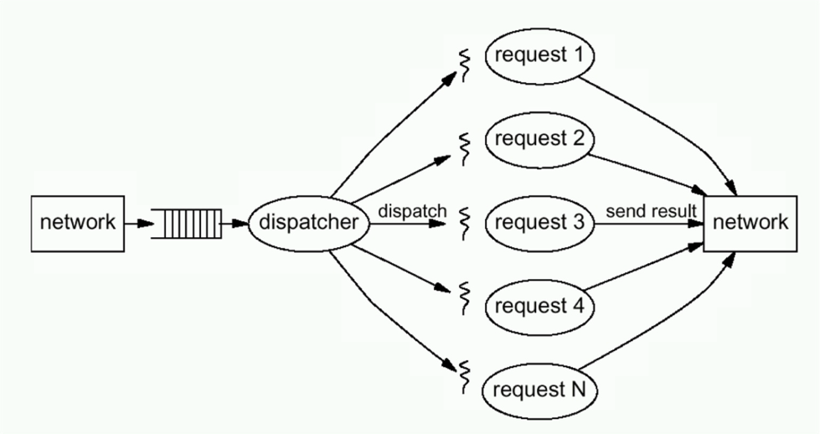
Thread-based Concurrency (thread per request allocated/created when receiving the request)

Slide 20
Thread-based Concurrency
Benefits
Simple, well-supported programming model
Drawbacks
High overheads as # of threads increases
Cache & TLB misses, scheduling, lock contention

Slide 21
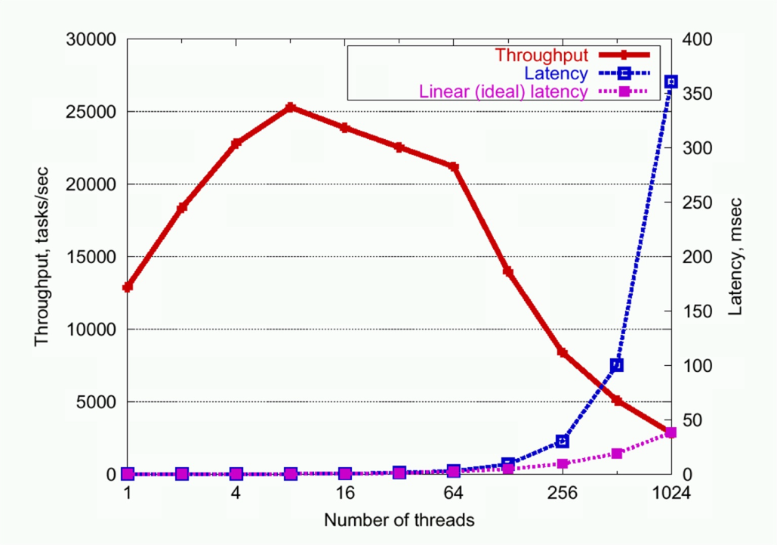
Threaded Server Throughput Degradation

Slide 22
Thread-based Concurrency
Benefits
Simple, well-supported programming model
Drawbacks
High overheads as # of threads increases
Cache & TLB misses, scheduling, lock contention
Tension between easiness of programming and ability to introspect and control resources
High cost for the application to characterize resource usage / request (thread)
Even more complex to arbitrate

Slide 23
… this does not support well a large number of concurrent requests
Strawman: let’s limit the concurrency level
(bounded thread pool)
Does not support my goal of ‘well-conditioned’ server
Unfairness
Potentially long-running requests hogging all threads
(note though that, depending on your specific environment
these may or may not be issues)

Slide 24
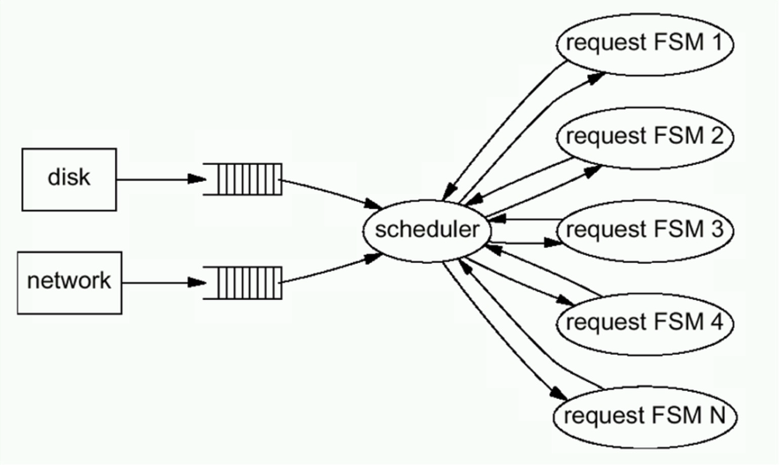
Event-driven Server
One way to think about this: Need to multiplex anyways. State to continue processing the request is maintained by the application (for event-driven) vs. maintained by the OS (thread-based)

Slide 25
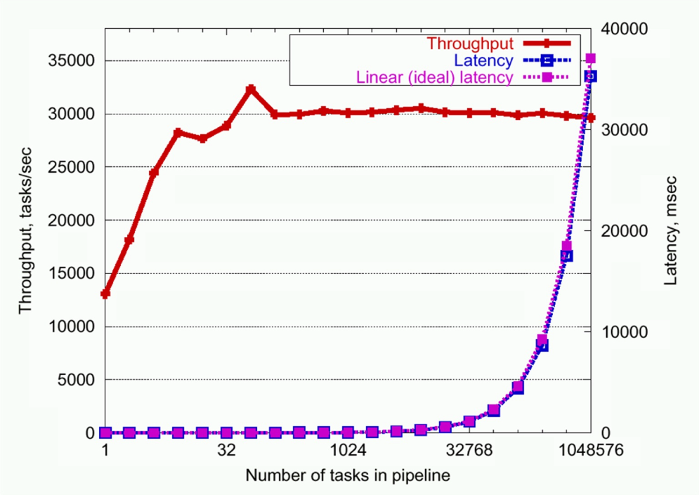
Event-driven Server Throughput

Slide 26
Event-driven Server
Benefits
Robust to high loads
Drawbacks
Harder to program
State machine
Additional concern on scheduling/ordering events (balance fairness and low response time)
Additional overhead if underlying subsystems do not offer an async API.
Can not block in event handlers
More direct control of resources

Slide 27
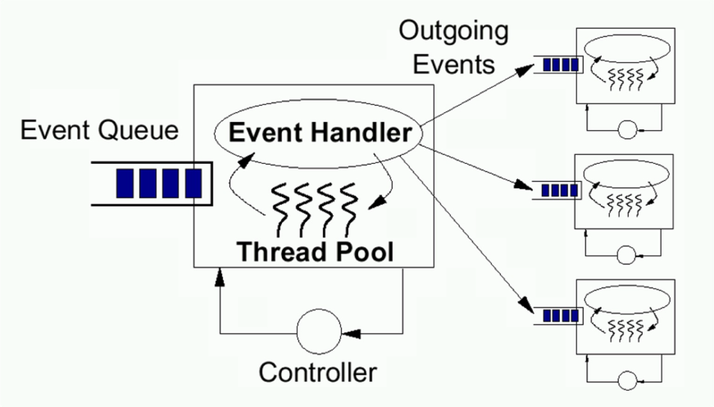
Network of queues
Key mechanisms
event-driven stages,
resource controllers
Support massive concurrency
Simplify construction of (well-conditioned) services
Enable introspection
Support resource management
Notes:
Matt Welsh et al., "SEDA: an architecture for well-conditioned, scalable internet services“, SOSP 2001 [pdf] [slides].
Matt Welsh reflecting on it 10 years later [link].
His PhD thesis with tons of details.
Control layer: USITS’03
Independent comparisons
David Pariag et al.'s paper in EuroSys 2007
Minor E. Gordon PhD thesis - Stage scheduling for CPU-intensive

Slide 28
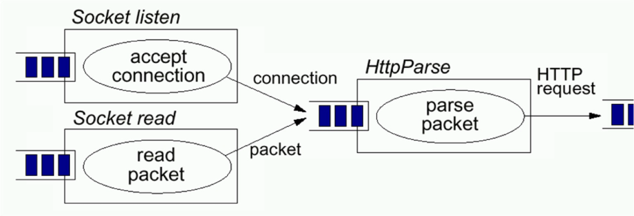
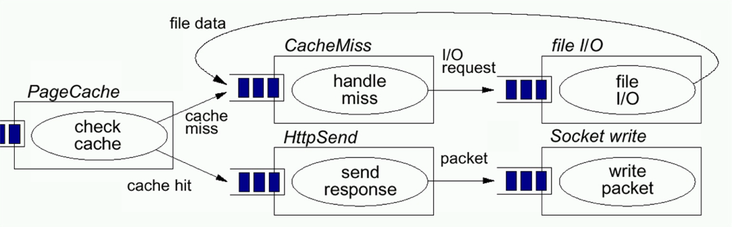
SEDA HTTP Server: Haboob
Load and resource bottlenecks explicit in the application programming model.

Slide 29
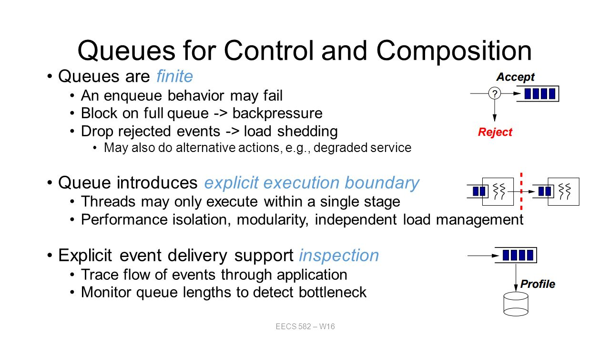

Slide 30
Server Design: Common Architectural Models
Thread-based concurrency
Event-driven server
Network of queues
Different tradeoffs between
performance, programming effort, fairness, ability to control overload situations, ability to monitor, ability to allocate resources
optimal choice will also depend on deployment platform and workload characteristics
Notes:
Matt Welsh et al., "SEDA: an architecture for well-conditioned, scalable internet services“, SOSP 2001 [pdf] [slides].
Matt Welsh reflecting on it 10 years later [link].
His PhD thesis with tons of details.
Control layer: USITS’03
Independent comparisons
David Pariag et al.'s paper in EuroSys 2007
Minor E. Gordon PhD thesis - Stage scheduling for CPU-intensive

